Slide 1
Marble Jar Task Instructions

Slide 2

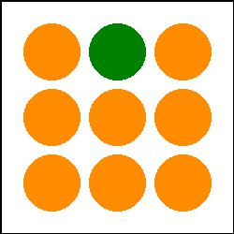
Introduction
Thank you for participating in this research project!
In this experiment, we will be studying human decision making, as well as visual memory
On each trial of the experiment, you will be shown two “marble jars”, each containing nine (9) randomly-generated marbles. An example might look like this:
Jar 1
Jar 2

Slide 3
Instructions
There are three different possible marble colors
The different marble colors are worth different amounts of points—some marbles are “worth” more than others
The task will explain how much each marble color is worth
You will need to remember what these marble jars look like:
Jar 1
Jar 2

Slide 4
Do you remember??

Slide 5
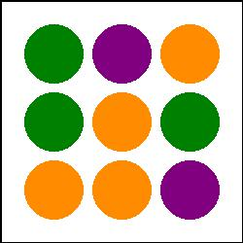
Instructions
On some trials you will be tested on your visual memory
You will be prompted with just one of the two marble jars, and asked to indicate whether the jar shown is the same or different than the one you saw previously. For example:
Is Jar 1 the same or different from the one you saw earlier?
Jar 1
Jar 2

Slide 6
Instructions
… Different
On other trials, you will be tested on decision making
After being shown two marble jars…
Jar 1
Jar 2

Slide 7

Instructions
… you will be asked to pick one of the two jars
Would you rather choose Jar 1, or Jar 2?
After you choose a jar, the experiment will randomly sample one marble from that jar. For example:
And you will earn an amount of points based on the marble color that is sampled

Slide 8


Instructions
Both types of trials (decision-making and visual memory) start out the same
In other words, when you are shown the two marble jars, you will not know whether it is testing decision-making or visual memory.
Each task occurs with 50% probability.
Jar 1
Jar 2

Slide 9
Instructions
The minimum payment for this experiment is $22. You can get paid more by performing well.
Answering correctly on memory trials will earn you more points
Choosing marble jars with higher expected value on the decision-making trials will also earn you more points
Try your best to earn as many points as possible during the task
Points will be translated into money paid to you at the end of the experiment
Each point is worth $0.045. Thus, scoring 550 points would equal a total payment of $24.75.

Slide 10
Questions?
Do you have any questions?
You will soon be given a chance to practice the task, and then you will begin the main experiment

